Slide 1
Introduction to deep learning
Laia Domingo
2021

Slide 2
Outline
What is deep learning?
Examples of deep learning
Brief history of deep learning
How does deep learning work?

Slide 3
What is deep learning?
Neural networks
Neural Networks (NN) is a biologically inspired programming paradigm which enables a computer to learn from observational data.
Deep learning
Deep Learning (DL) is a powerful set of techniques for learning in neural networks.
NN and DL currently provide the best solutions to many problems in image recognition, speech
recognition, and natural language processing.

Slide 4
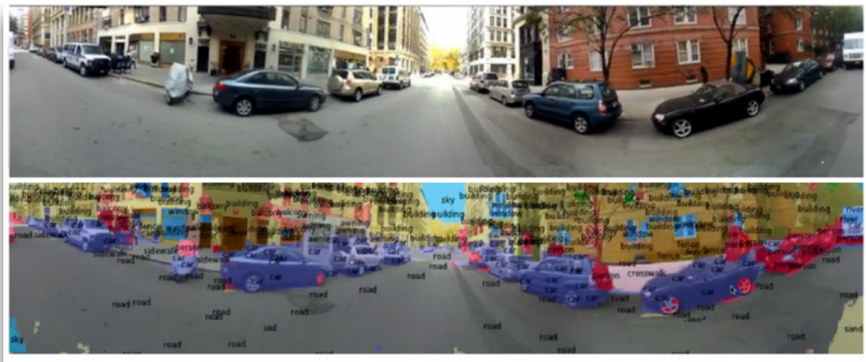
Deep learning everywhere
Figure: object classification, detection and segmentation.

Slide 5
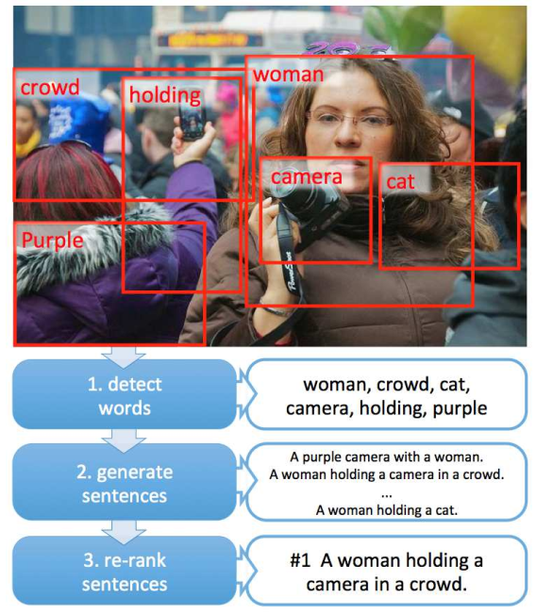
Deep learning everywhere
Figure: Image classification

Slide 6
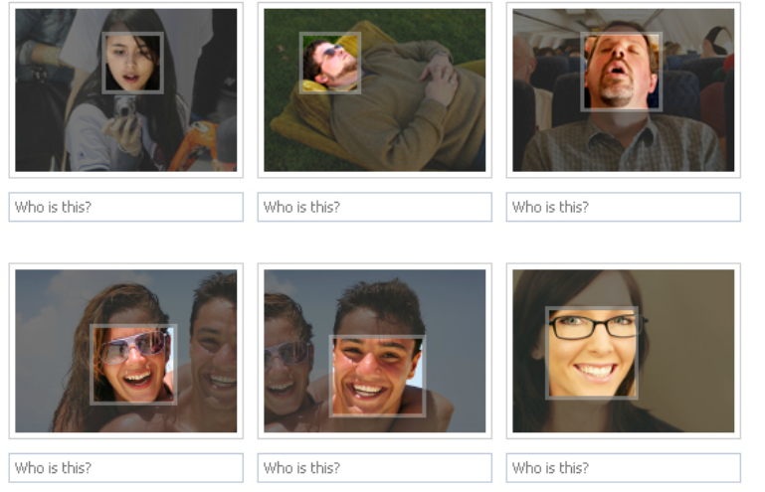
Deep learning everywhere
Figure: Face recognition

Slide 7
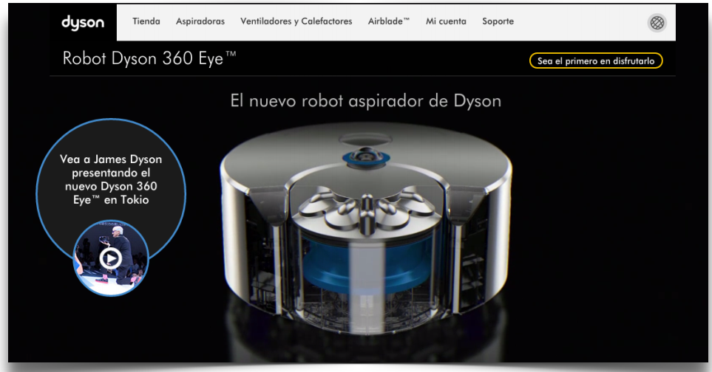
Deep learning everywhere
Figure: Navigation and mapping.

Slide 8
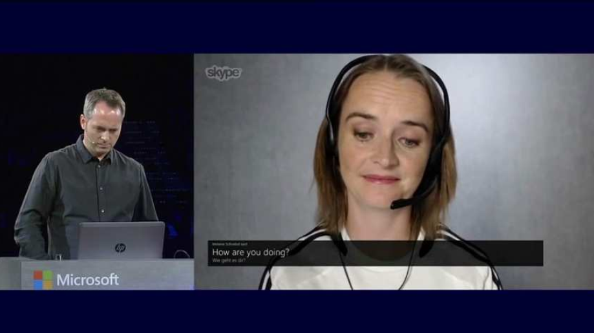
Deep learning everywhere
Figure: Skype translator

Slide 9
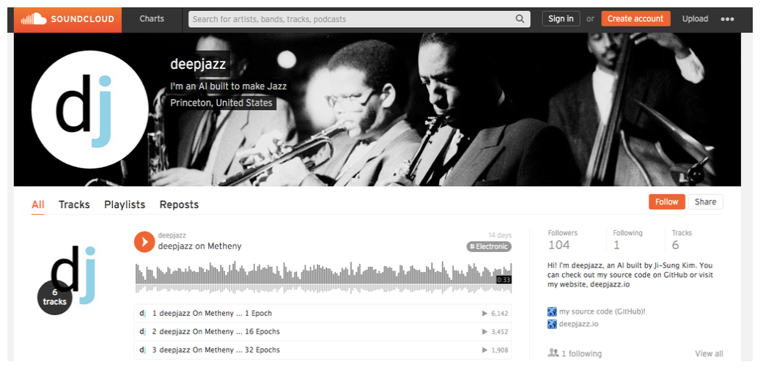
Deep learning everywhere
Figure: Music generation

Slide 10
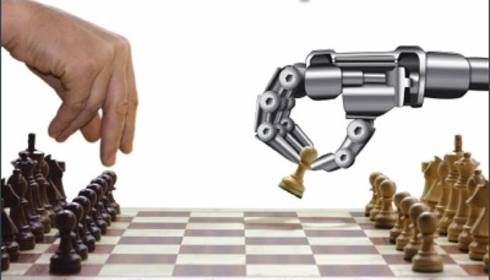
Deep learning everywhere
Figure: Playing chess

Slide 11
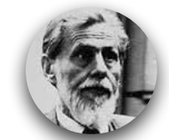
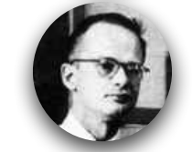
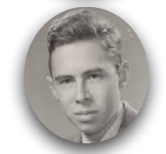
Brief history of deep learning
In 1943, neurophysiologist Warren McCulloch and mathematician Walter Pitts wrote a paper on how neurons might work. In order to describe how neurons in the brain might work, they modeled a simple neural network using electrical circuits.
In 1957 Frank Rosenblatt attempted to build a kind of
mechanical brain called the Perceptron, which was billed as
“a machine which senses, recognizes, remembers, and
responds like the human mind”.

Slide 12
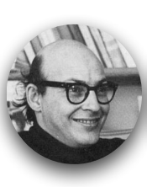
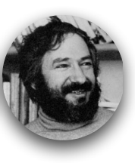
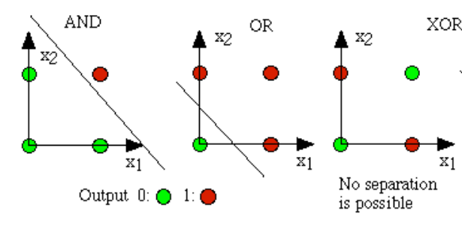
Brief history of deep learning
A critical book written in 1969 by Marvin Minsky and his collaborator Seymour Papert (“Perceptrons”) showed that Rosenblatt’s original system was painfully limited, literally blind to some simple logical functions like “exclusive-or”. What had become known as the field of “neural networks” all
but disappeared.

Slide 13
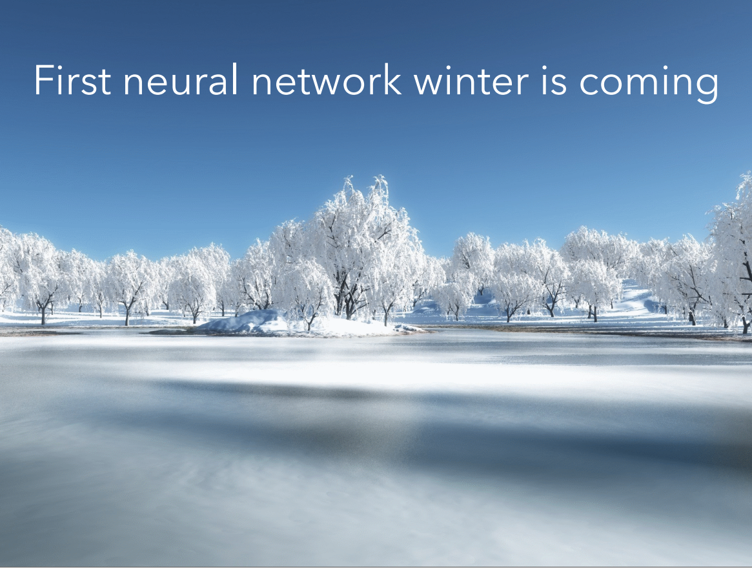

Slide 14



Brief history of deep learning
In 1986, the problem was how to extend the Widrow-Hoff rule to multiple layers. Three independent groups of researchers, which included David E. Rumelhart, Geoffrey E. Hinton and Ronald J. Williams, came up with similar ideas which are now called backpropagation networks because it distributes pattern recognition errors throughout the network.
From 1986 to mid 90’s new developments arised: convolutional neural networks (Y.LeCun), unsupervised learning (Y.Bengio), RBM (G.Hinton), etc. But, by this point new machine learning methods had begun to also emerge, and people were again beginning to be skeptical of neural nets since they seemed so intuition-based and since computers were still barely able to meet their computational needs.

Slide 15
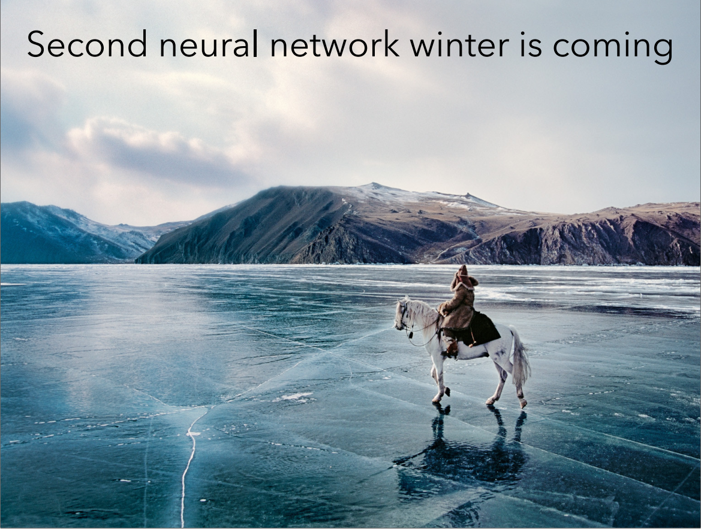

Slide 16
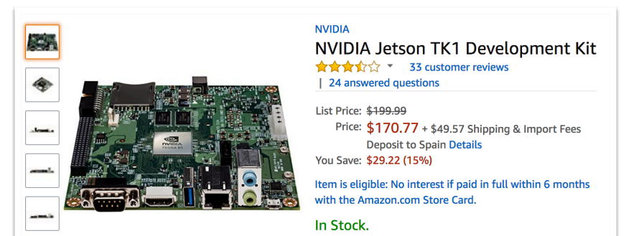
Brief history of deep learning
Then, what every researcher must dream of actually happened:
G.Hinton, S.Osindero, and Y.W.Teh published a paper in 2006 that was seen as a breakthrough, a breakthrough significant enough to rekindle interest in neural nets: A fast learning algorithm for deep belief nets.
After that, following Moore’s law, computers got dozens of times faster (GPUs) since the slow days of the 90s, making learning with large datasets and many layers much more tractable.

Slide 17
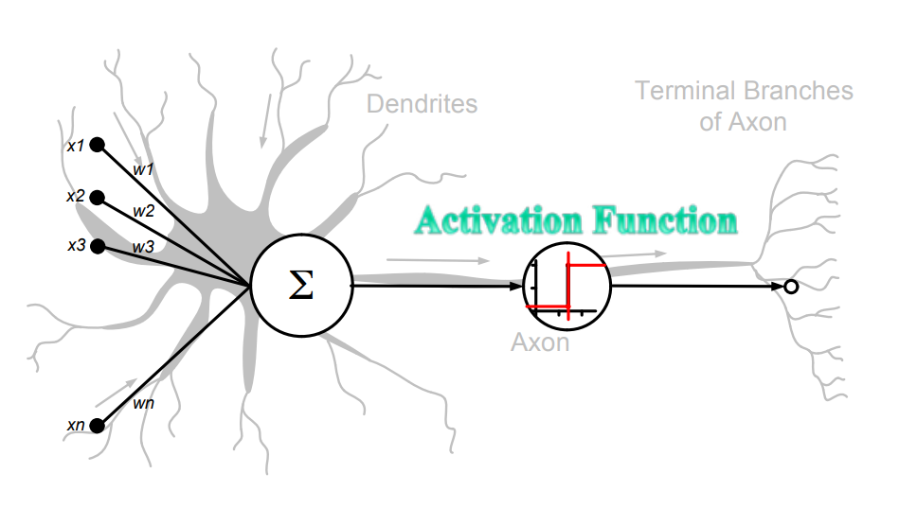
How does deep learning work?

Slide 18
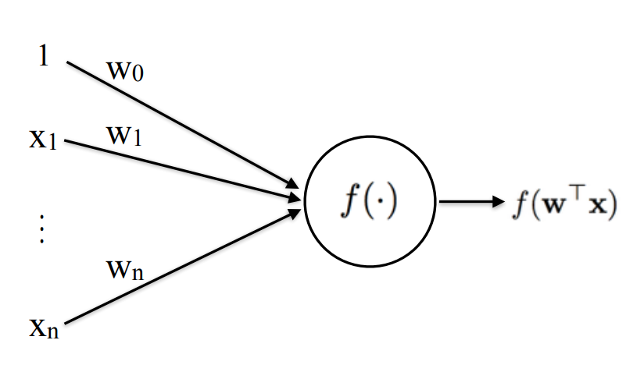
How does deep learning work?
The perceptron: a single artificial unit

Slide 19
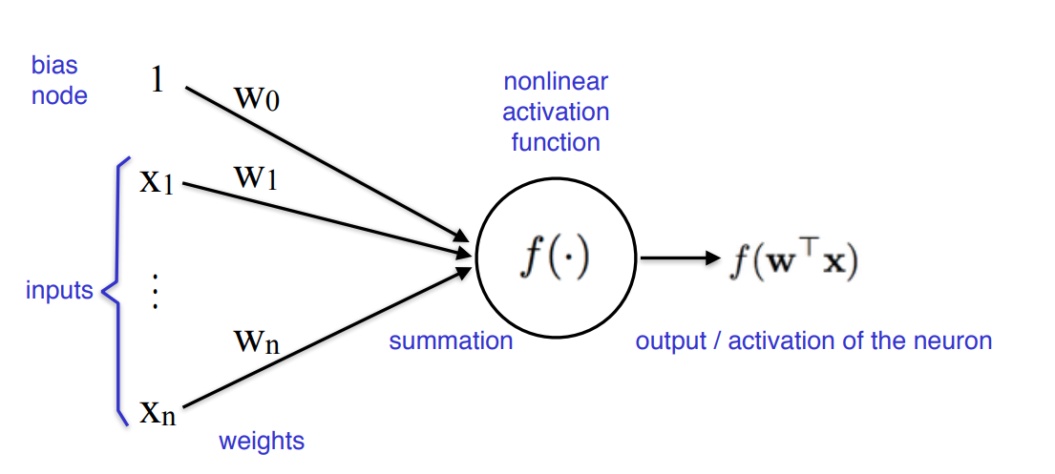
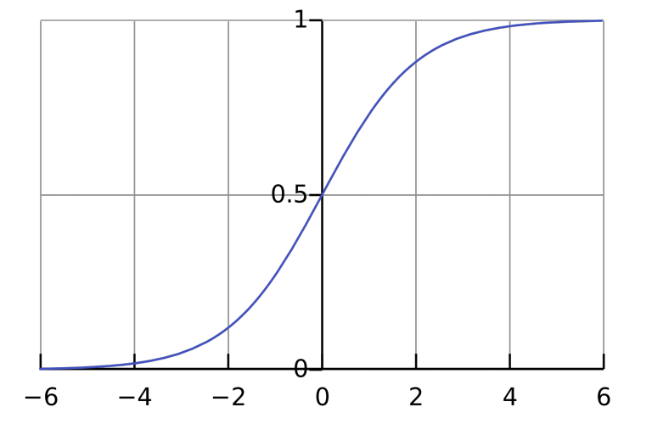
How does deep learning work?
The perceptron: a single artificial unit

Slide 20
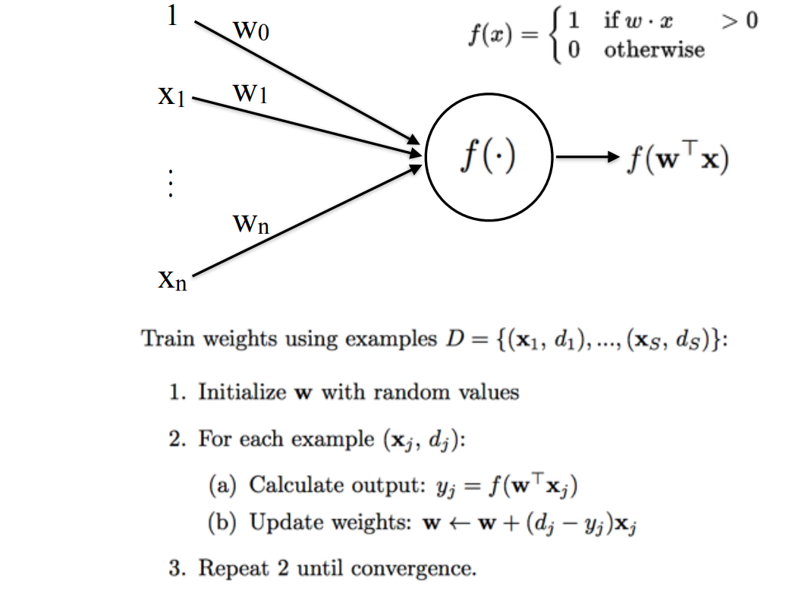

The perceptron

Slide 21
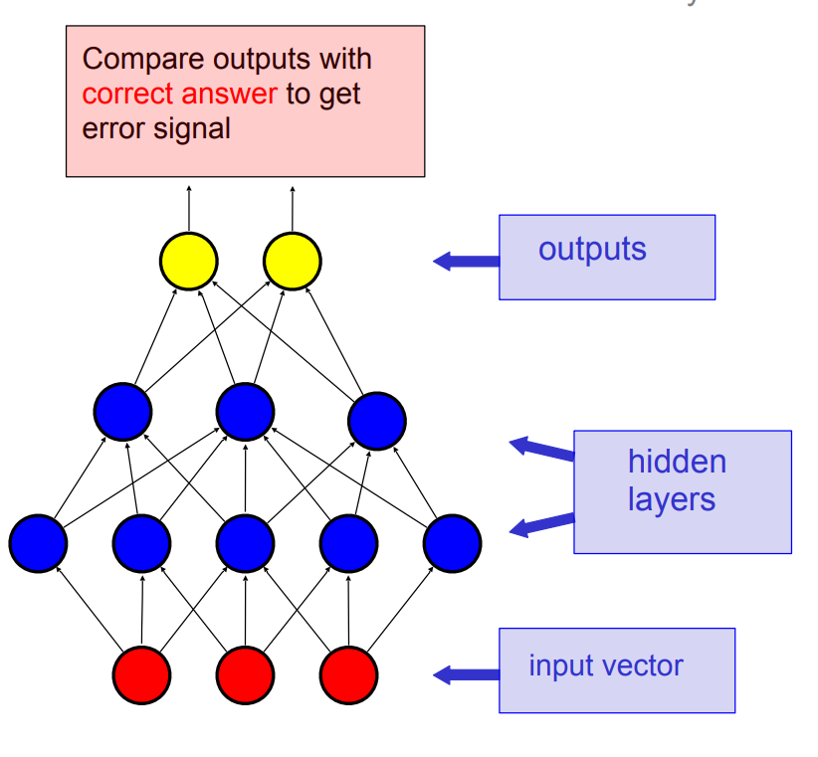
Modern neural networks

Slide 22
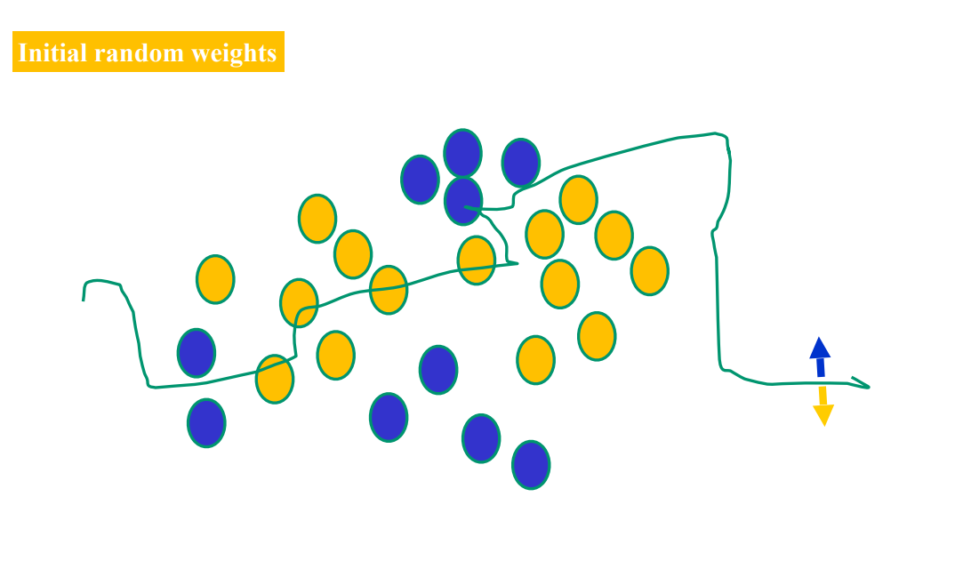
Example

Slide 23
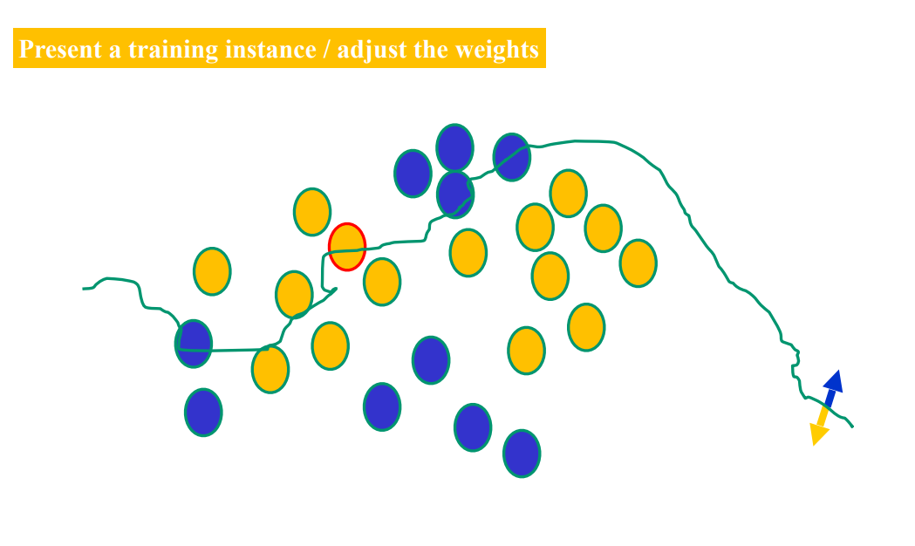
Example

Slide 24
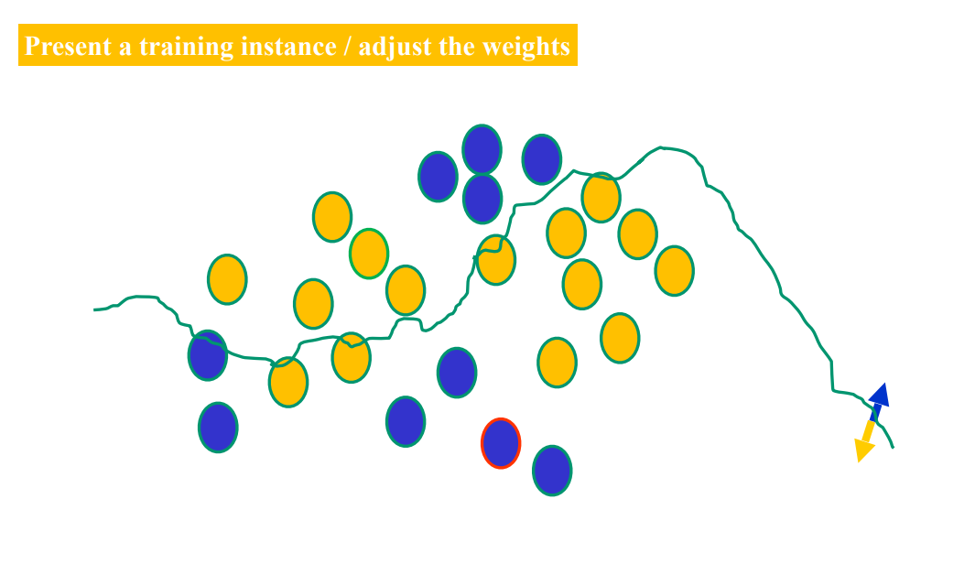
Example

Slide 25
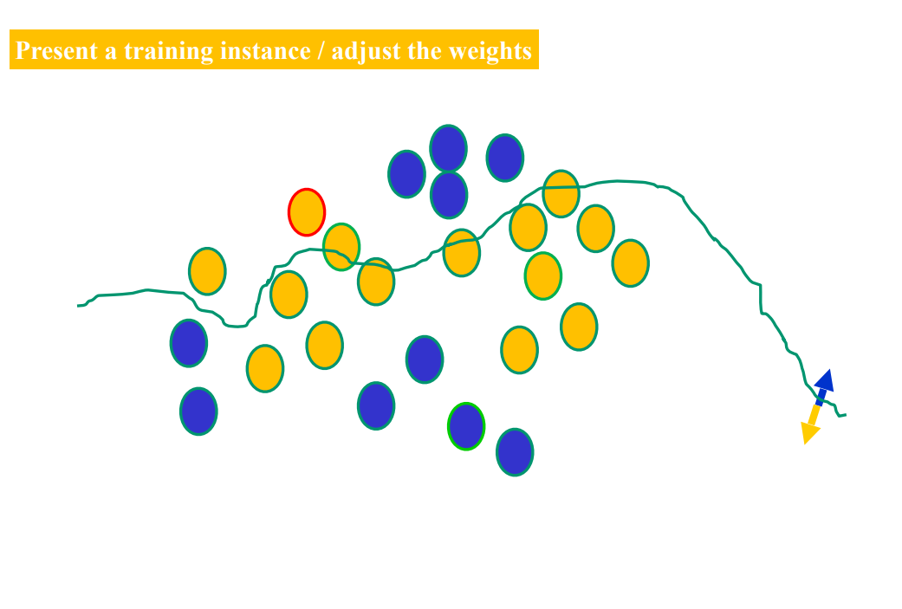
Example

Slide 26
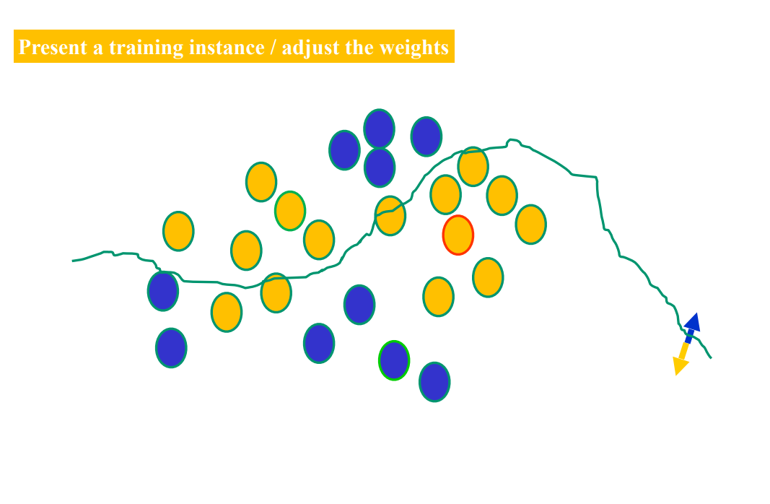
Example

Slide 27
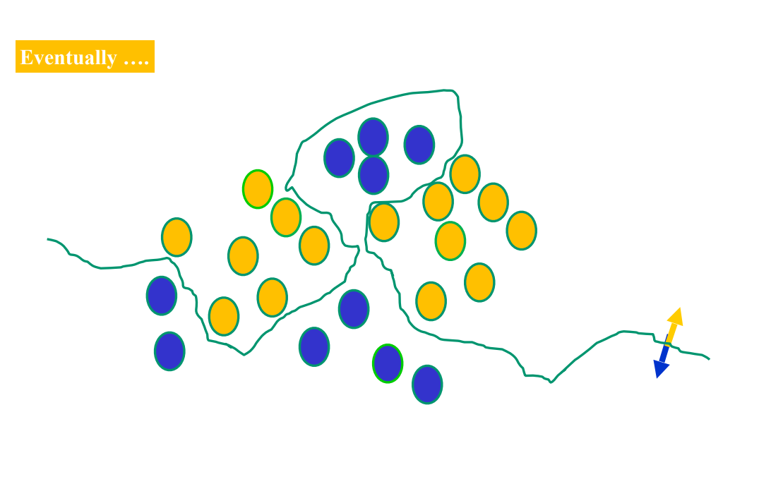
Example

Slide 28

Example: digits recognition
Consider the following hand-written sequence:
Most people easily recognize the sequence as: 504192. That ease is deceptive.
How would you write a computer program to identify these numbers?

Slide 29
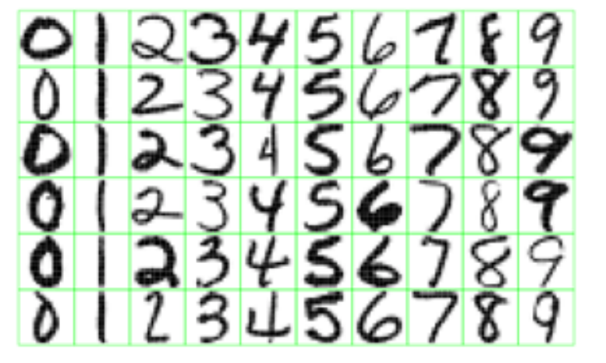
Example: digits recognition
Layer 2
Layer 1
w₂₁
Layer 3
w₃₁
Input
w₁₁
.
.
.
.
.
.
w₄₁
w₁₂
Output
w₄₂
w₁₃
5
w₄₃
w₁₄
w₂₅
w₃₃
Each layer extracts a feature (property) of the image
What features do you expect the neural network to learn?

Slide 30
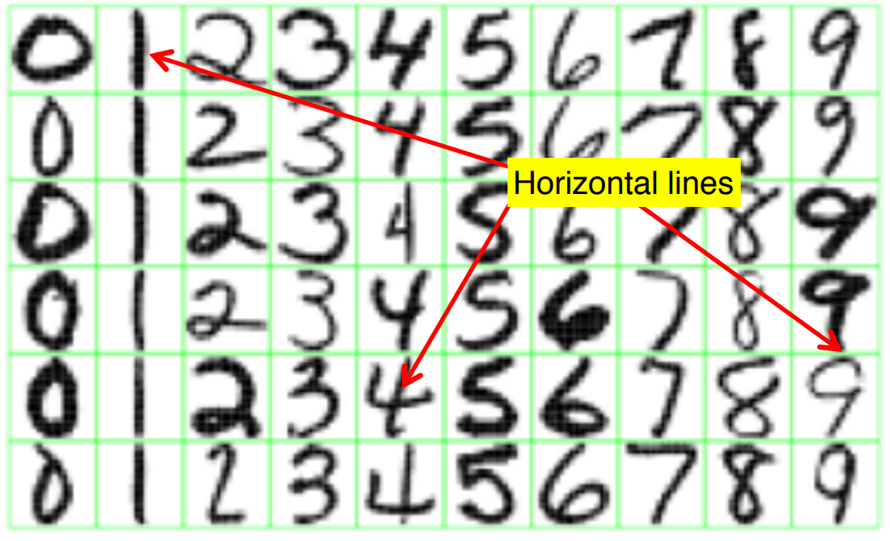
Example: digits recognition

Slide 31
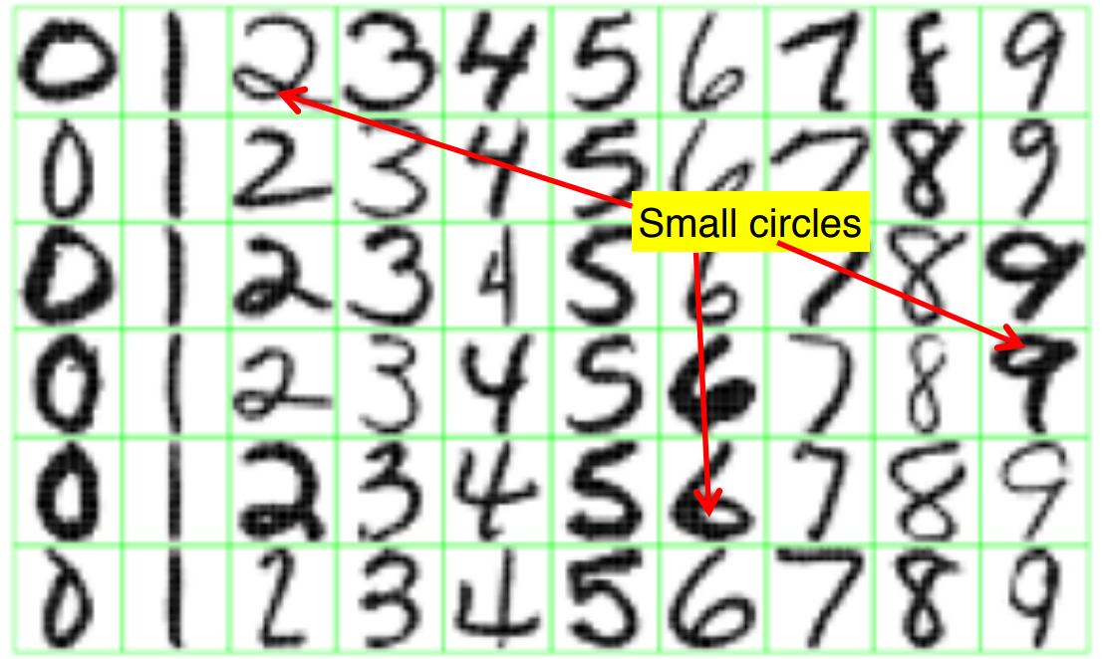
Example: digits recognition

Slide 32
Playing with neural networks
http://playground.tensorflow.org

